Slide 1



Analysis of
Indian Electoral Data
- Data Visualization Project -

Slide 2



Team Members
PRESENTED BY:
Aditya Dhaduk (B21AI014)
Lakshit Chaubisa (B21AI057)
Harsh Soni (B21AI016)
Rushi Shah (B21AI032)
Khushal Sindhav (B21AI039)
Source Code Link:- https://github.com/Aditya2814/Indian-General-Elections-data-1977-2014-Analysis-and-Visualisation

Slide 3



Introduction
National-Data Analysis
State-Wise-Data Analysis
Constituency-Wise Data Analysis
Lying with Statistics
Contents

Slide 4


Introduction

Slide 5

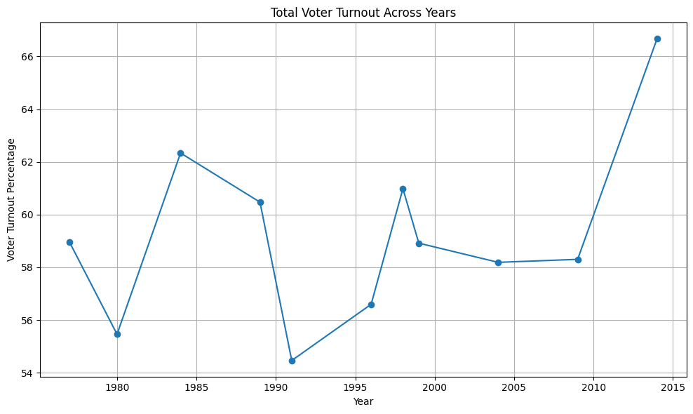

Introduction
This projects has details regarding the analysis of electoral data of India. This Analysis of data has been done at national as well as state level.
Furthermore we are going to analyze how can someone lie using statistics of these analysis.

Slide 6


National Data Analyisis

Slide 7
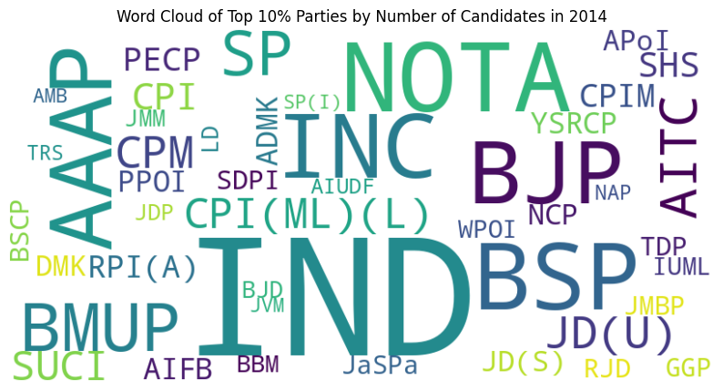
Top 10% Parties by Number of Candidates

Slide 8
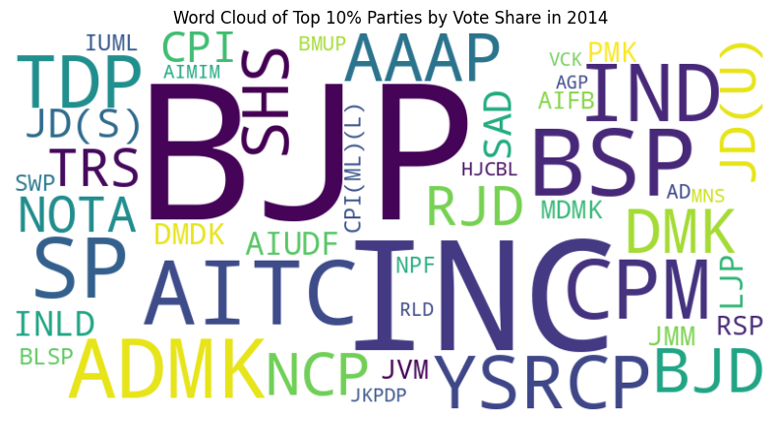
Top 10% Parties by by Vote Share

Slide 9
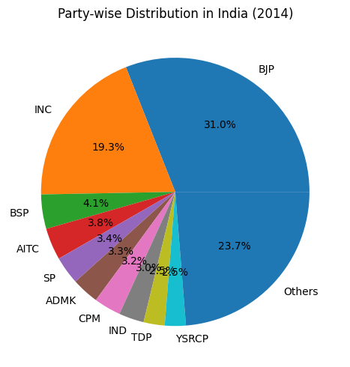
Party-Wise Distribution of votes for Differrent Parties

Slide 10
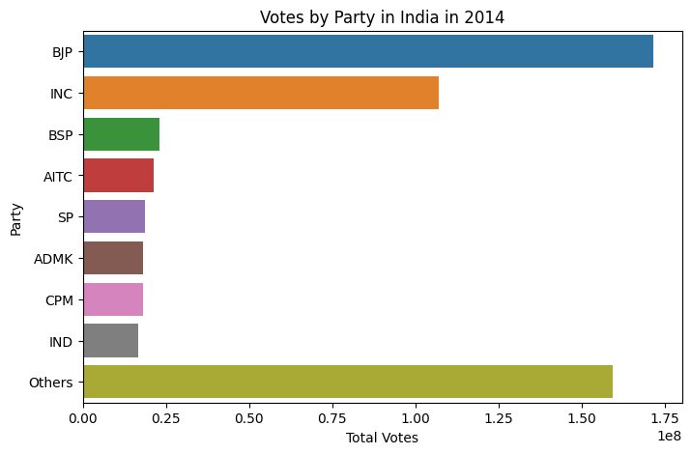
Votes by Parties in India

Slide 11
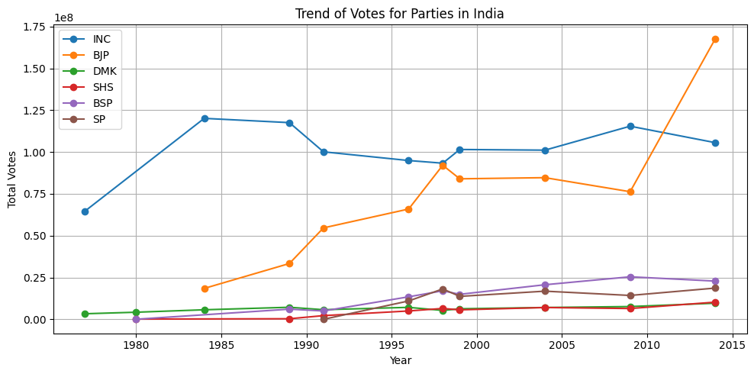
Voting Trend for Parties in India

Slide 12
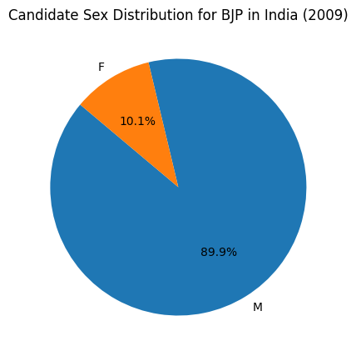
Candidate Sex Distribution for BJP

Slide 13
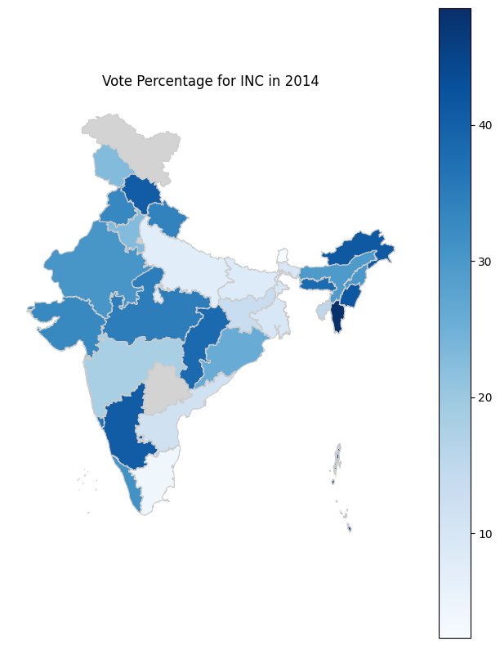
Percentage Vote Distribution for INC

Slide 14
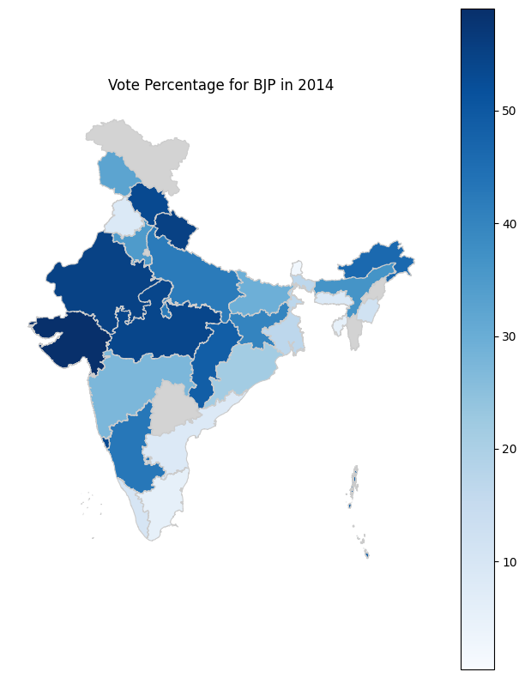
Percentage Vote Distribution for BJP

Slide 15



State-Wise Data Analysis

Slide 16
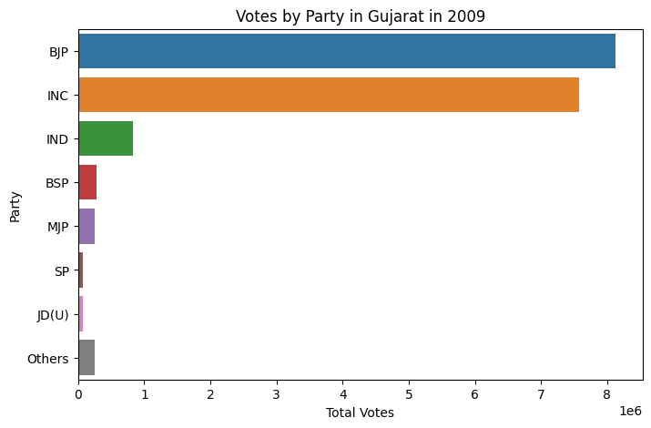

Votes to Parties

Slide 17
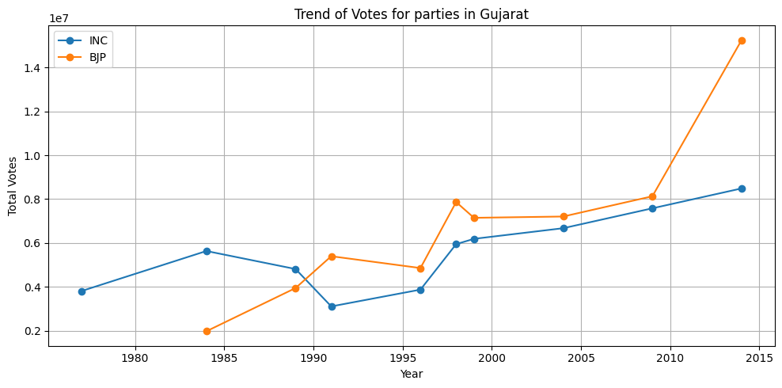
Comparison of voting trend for parties

Slide 18
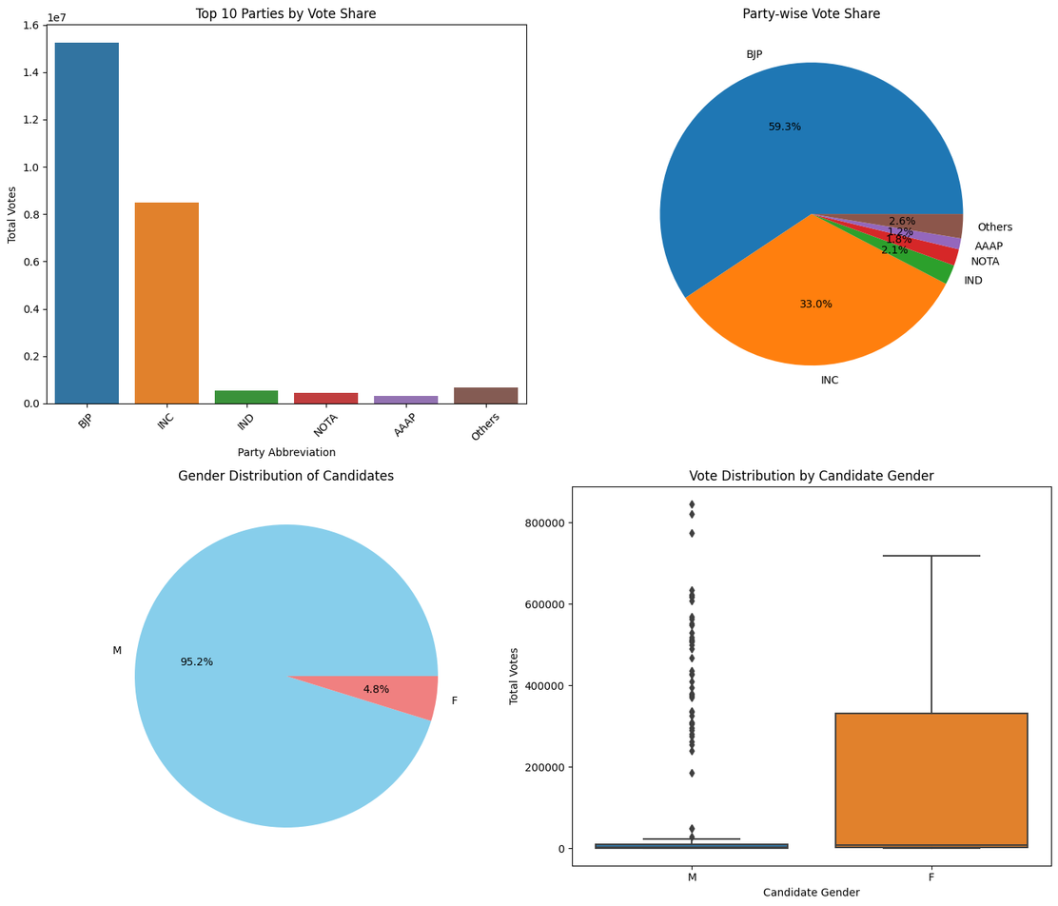
Comparison of voting trend for parties

Slide 19
Constituency-Wise Data Analysis

Slide 20
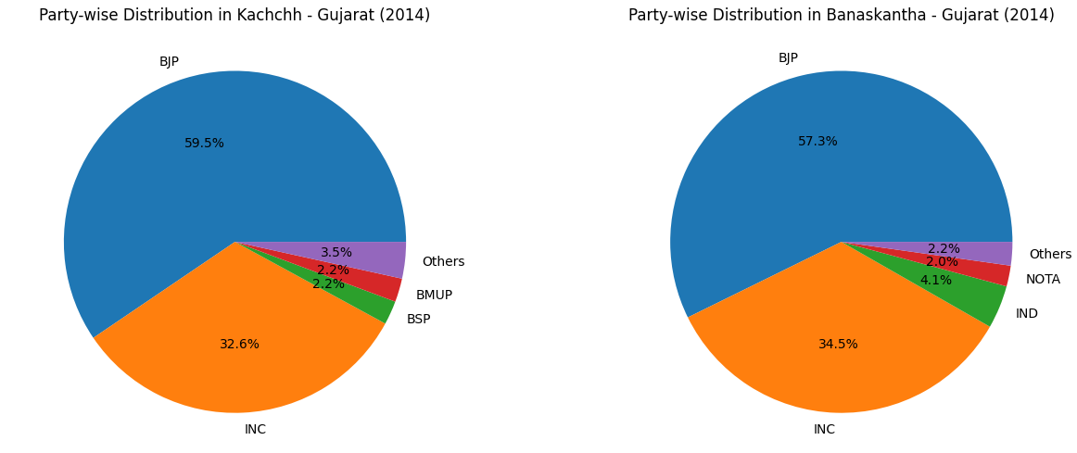
Constituency wise vote distribution for parties

Slide 21
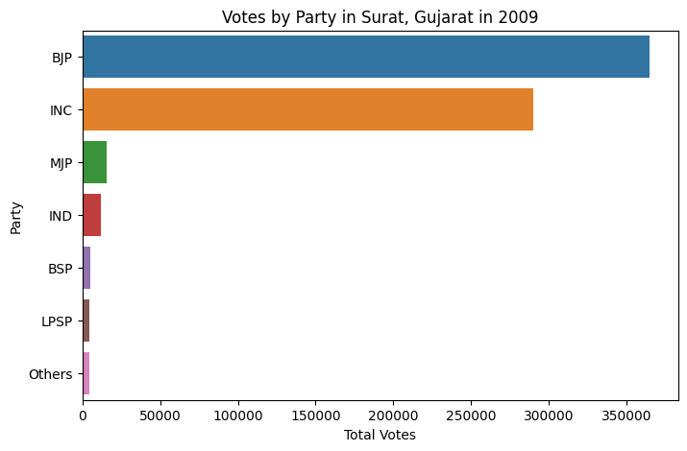
Vote Share for parties in Surat, Gujrat

Slide 22
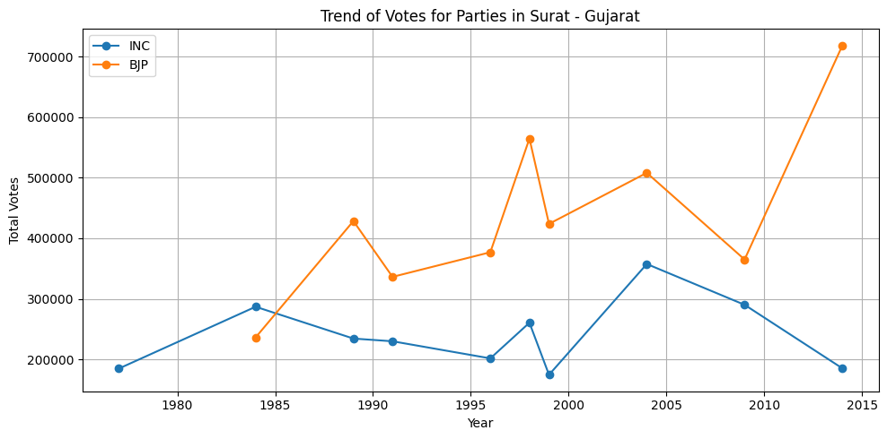
Trend of votes for parties in Surat, Gujrat

Slide 23
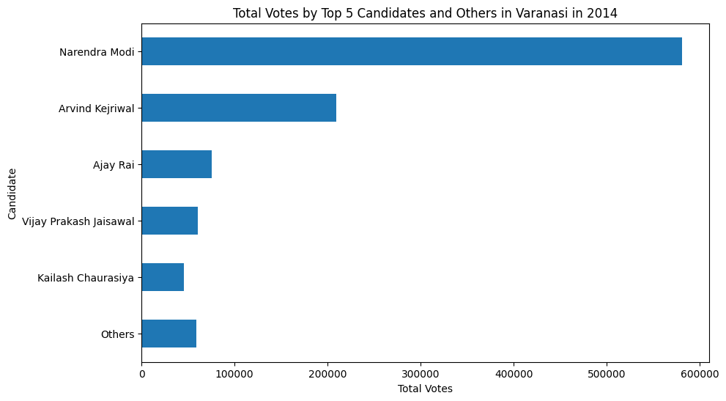
Trend of votes for Candidates in Varanasi

Slide 24
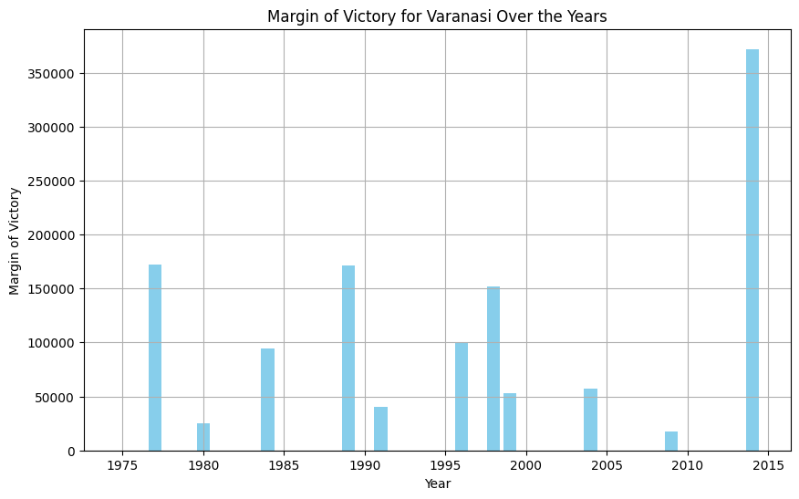
Margin of victory for parties in Varanasi

Slide 25
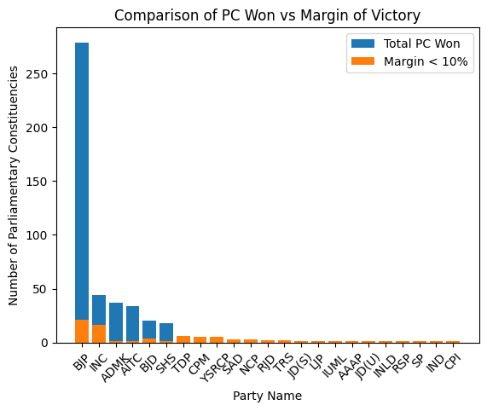
Comparison of Parliamentary Constituencies

Slide 26
Lying with Statistics

Slide 27
Lying with Statistics
Misleading visualizations can have significant effects on elections by shaping public opinion, influencing voter behavior, and impacting electoral outcomes in the following ways:
Shaping Perception of Candidates
Creating False Narratives
Discouraging Voter Turnout
Impact on Fundraising and Support

Slide 28
Several ways in which someone could spread false narrative by visualization
Several ways in which someone could spread false narrative by visualization are:
Presenting only the final winning numbers without considering the margin of victory can indeed spread a false narrative
It may be possible that some party has won many seats but the margin in most of the seats are not very large.
Solution : With the winning seats number also present the seats where there are tough fights.

Slide 29
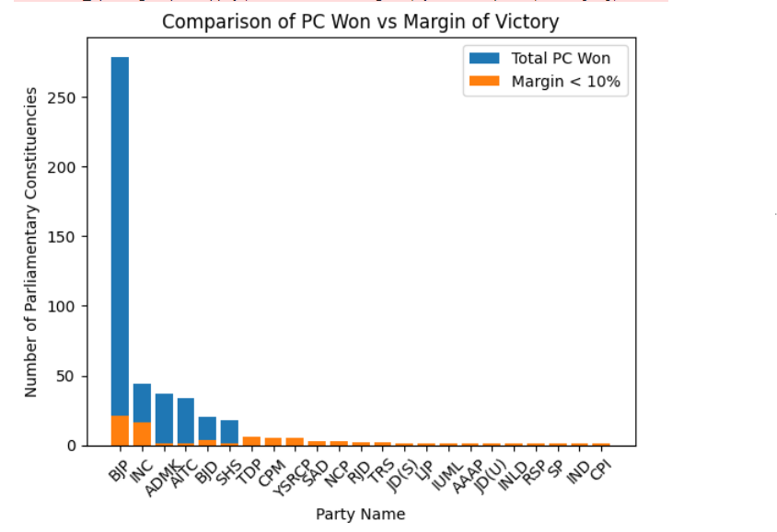
How can we use visualization to mislead people ?
Visualization of seats won by different parties along with the seats where the winning margin is less than 10% to show a clear picture of mandate.

Slide 30
Several ways in which someone could spread false narrative by visualization are
:
Do not considering the voting percent of the constituency and nota votes shares can distort the perception of the mandate.
For instance, a candidate or party may win a seat with a relatively low percentage of the total votes cast, indicating that they do not have broad support across the constituency. However, without considering the voting percentage, it may falsely appear as a strong endorsement from the electorate.

Slide 31
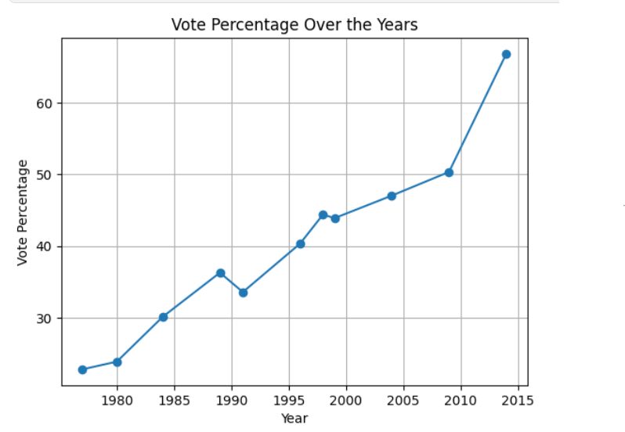
Several ways in which someone could spread false narrative by visualization are
SOLUTION :
With the winning seats/number/votes also show the voting percent of people, vote percent of a party and vote share of Nota to give a clear picture of mandate

Slide 32

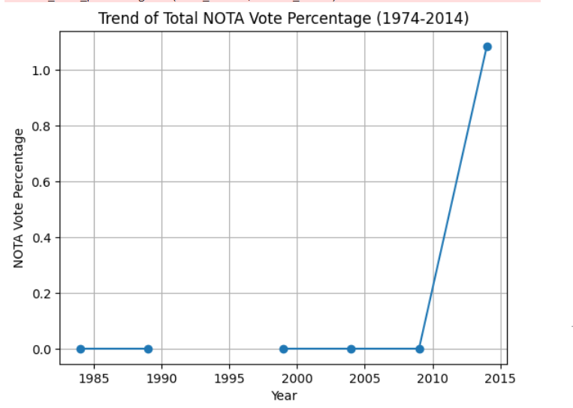
Several ways in which someone could spread false narrative by visualization are
SOLUTION :
With the winning seats/number/votes also show the voting percent of people and vote share of Nota to give a clear picture of mandate.
Therefore we had plotted both vote percent for a party and nota share to give a clear picture

Slide 33
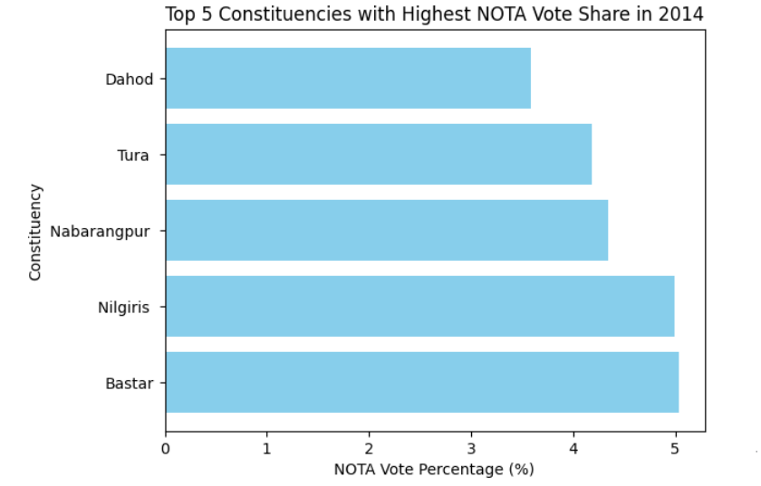
Several ways in which someone could spread false narrative by visualization are
SOLUTION :
With the winning seats/number/votes also show the voting percent of people and vote share of Nota to give a clear picture of mandate.
Therefore we had plotted both vote percent for a party and nota share to give a clear picture

Slide 34
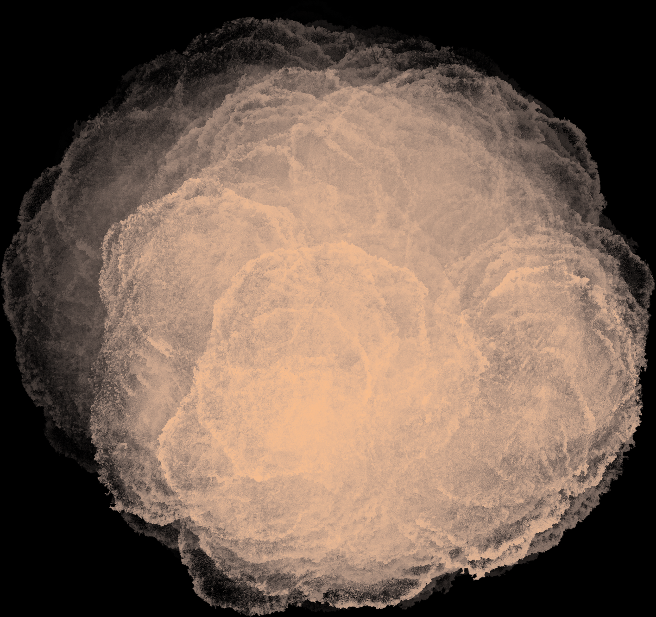
Thank
you

